Slide 1


Automated Chess Board
Team
Sanjana Nalawade
Soundarya Nevrekar
Jahnavi Naik

Slide 2
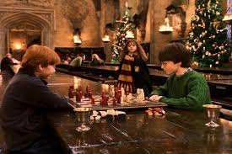
Introduction
From childhood, we have all been fascinated with the idea of chess pieces moving on their own. Hence, taking inspiration from the Harry Potter series, we decided to bring it to life!

Slide 3
Problem Statement
To make an Automated Chess Board that can move chess pieces automatically.
This game will be played between two players.

Slide 4
Objective
Game can be played in the given mode
Player1 vs Player2
Since it automatically moves the chess pieces on input, it will be fun for the players and viewers too.

Slide 5
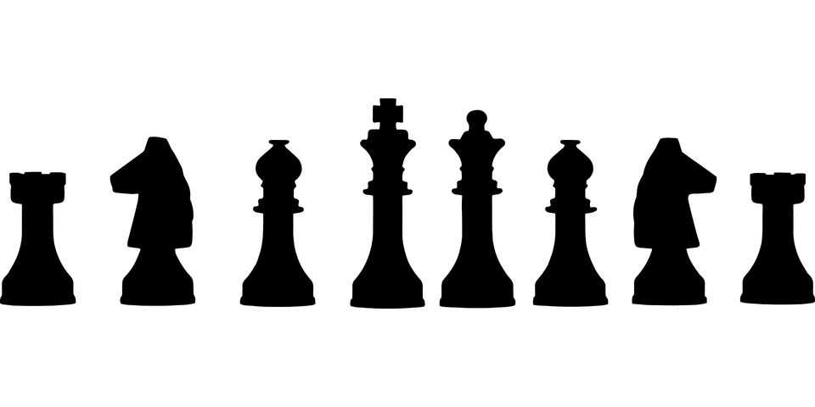
Application Area
This automated chess board would have its application highly related to the area of Entertainment

Slide 6
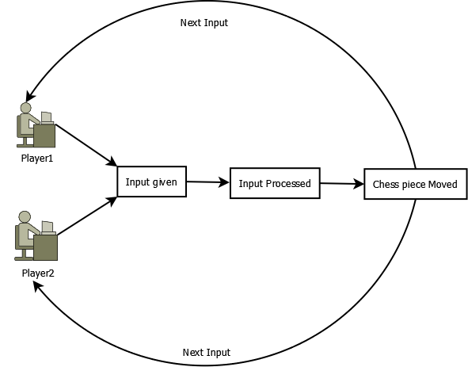
State Diagram

Slide 7
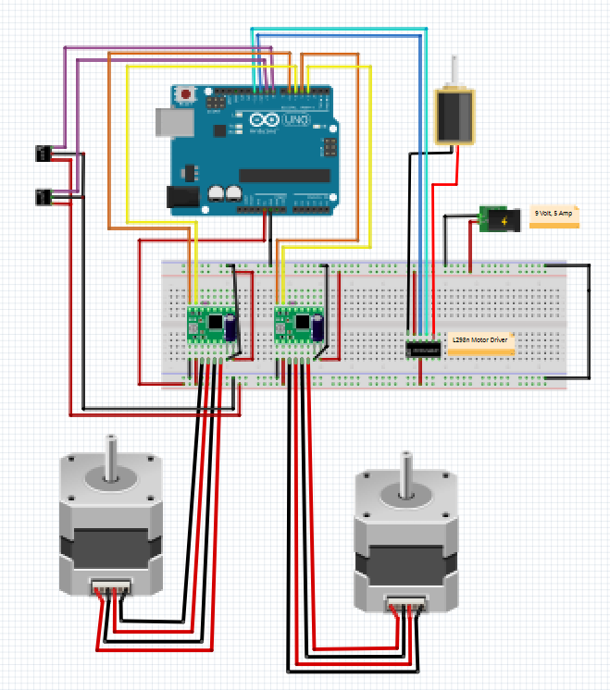
Circuit Diagram

Slide 8
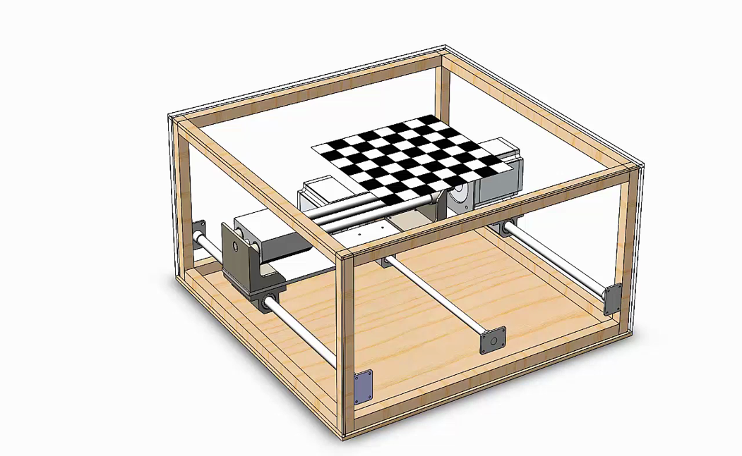
Hardware + Software Requirements
Hardware
Arduino UNO
Stepper Motor × 2
Stepper motor driver board A4988 × 2
H-Bridge motor driver L298
Electromagnet 5V; 50N
Micro Limit Switch × 2
Linear Bearing Block × 5
Steel Rod Stock
Timing Belts
Pulleys
Polycarbonate Sheet
Capacitor 100 µF × 2
Software
Arduino IDE

Slide 9
Future Scope
For further advancements, there could be developments like voice control. Commands could be issued verbally.
Additionally, by including a server, long distance playing would be possible. Opponents don't need to be in the same location for a game.

Slide 10
References
[1] Automated Chess Board
https://create.arduino.cc/projecthub/maguerero/automated-chess-board-50ca0f?ref=user&ref_id=313008&offset=2
[2] Wooden Chess Board with Piece Recognition
https://create.arduino.cc/projecthub/Maxchess/wooden-chess-board-with-piece-recognition-872ffb
[3] Automated Chess Board
https://www.hackster.io/maguerero/automated-chess-board-50ca0f
[4] Implementation of the Automatic and Interactive Chess Board
http://www.iosrjournals.org/iosr-jeee/Papers/Vol9-issue6/Version-1/A09610104.pdf
[5] Automated Chess Piece Mover
https://www.hackster.io/Moustafaidris97/automated-chess-piece-mover-39c7de

Slide 11
Conclusion
The Automated Chess Board creates new interest in a classic game. It also makes the game more accessible to people who cannot physically move the chess pieces.

Slide 12
Thank You!

